Slide 1
The Pocket Beach
By: Brandon Kenny
Nam Vo
Kevin Wieser
Javier Zambrano

Slide 2
Overview
Problems- What problems our app will be addressing
Solutions- How our app will be addressing said problems
Demonstration- We will be accessing our prototype and showing the functionalities of the app.
Website- Show our website
Business Model
Future Plans
Questions- Open up for questions.

Slide 3
Problem
As a student, having to navigate through various Long Beach applications for daily routines
Not having any mobile friendly way to register for classes
Not easy to find out what is happening on and off campus
Inefficient use of time
Easy to get stuck in a routine

Slide 4
Solution
A one stop app for students
To provide a mobile friendly platform to register for classes, to allow users to preset registration schedules in order to automatically register at their given time.
Allow users to stay informed about all the activities happening on campus and off campus.
To help build a daily agenda to make users become more time efficient in their day to day schedules.

Slide 5
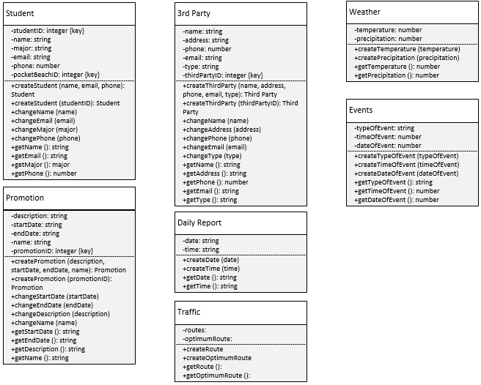

Slide 6
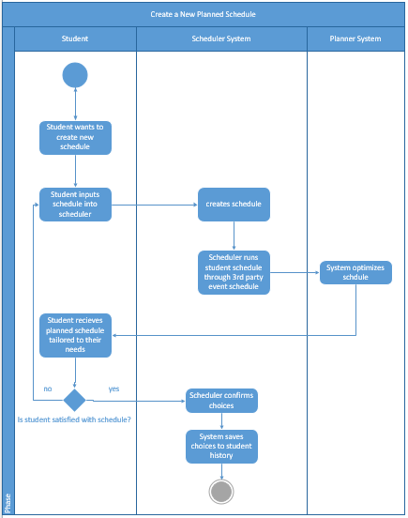
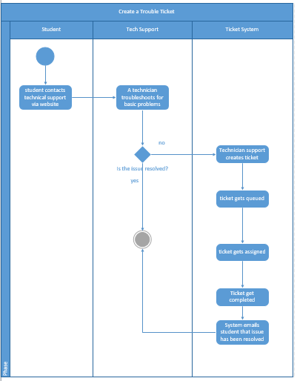

Slide 7
Demonstration

Slide 8
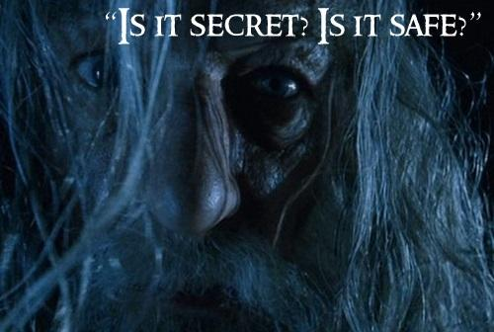
Securing user data

Slide 9
Bcrypt
A password hashing function based on the Blowfish encryption algorithm.
Can be implemented in multiple coding languages
Tested with other popular mobile applications
Designed to be slow

Slide 10
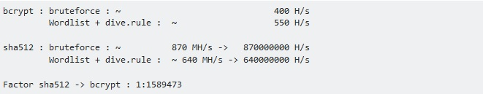
Why Bcrypt?
Sha-2 vs Bcrypt
Less susceptible to a rainbow attack, or dictionary attack
Needs more complex(expensive) hardware in order to crack

Slide 11
Website

Slide 12
Business Model
Summary: We are looking for a sponsorship business model, advertisers gain inclusion in our app by funding rewards for users, who earn these rewards by engaging more with our app.
This way our application is adapted for many verticals
This advertising strategy will likely be better received by app users because it is relevant and related to an app’s purpose
Promotional marketers earn revenue, advertisers get more ad space, and users benefit from free promos
This form of advertising can be aligned with our app’s conversion funnels
Student Donations

Slide 13
Future Plans
Aesthetics
Class schedule page
Link up with ratemyprofessor
Show total enrolled students the class may have
Show professor past and current classes (in case you like a professor)
Make our app cross platform
Add parking functionality
Expand to other schools
Buy and sell textbooks
Read textbook and be able to take notes directly on app

Slide 14
Any Questions??

